Slide 1
Teacher Refresher Training
Notes:
Welcome, logistics, introductions, as necessary.
Teachers will need a copy of the “Teacher Refresher Training Guide” – one per teacher.
(A separate file is provided.)

Slide 2
Three-Minute “Speech”
Three-Minute “Speech”
2
2
What is the core reason you do the work you do?
Notes:
Materials: Training Guide page 2.
This exercise is a quick strategy for building a sense of community and shared vision tied to students.
3 minutes: Have participants respond to the question on the slide and write their response on page 2 in order to create their “Three-Minute Speech”.

Slide 3
Three-Minute “Speech” – 2
Find a partner from another table.
Both partners will share their speech.
Be prepared to debrief key points.
Notes:
Materials: Training Guide page 2.
Using their three-minute speeches, the teachers will find a partner from another table and stand together as partner pairs. Select a strategy for pairing them together, e.g., “find someone from another table who is wearing the same color of clothing as you… or fine someone from another table that you don’t normally work closely with…”
8 minutes: Both partners will each share their speech. Allow 4 minutes for each person to share (8 minutes total). Remind them that they should discuss “why” they selected to write what they did. What does their “voice” convey?

Slide 4
Three-Minute “Speech” – 3
What were the key points that surfaced from your speeches?
Why is it important for us to continuously improve our practices?
Notes:
2 minutes: Debrief key points with the whole group by asking, “What were the key points that surfaced from your speeches?”
Listen to responses.
The second round of the large group debrief includes (click twice on the slide): “Why is it important for us to continuously improve our practices?”

Slide 5
Objectives:
The participants will:
Reflect and deepen their understanding with the T-TESS process;
Reflect on T-TESS implementation and the impact on self, teachers, students, and the campus; and
Identify next steps for growth and development (self and campus).
Notes:
Emphasize the fact that all teachers will be supported to gain a clear understanding of the rubric in its revised form and how it applies to their roles and responsibilities with teaching and learning.
(Each objective appears with a separate click for each bullet.)
“The objectives for today are that each of you will….
Reflect and deepen your understanding with the T-TESS process as an ongoing means of continuous improvement. Each year we can anticipate that we will refine and improve our work in this area.
Reflect on T-TESS implementation and the impact on self, teachers, students, and the campus to assess how effective the implementation was and the impact on both teacher and student performance. … And
Identify next steps for growth and development at both the individual or “self” and campus levels.

Slide 6
T-TESS Teacher Reflection: Plus and Delta
2
What were the T-TESS strengths and why?
Where might we improve T-TESS implementation?
Notes:
Materials: Sticky notes, charts, and markers. Training Guide page 2.
Provide teachers with two sticky notes to place on their graphic on page 2, as noted on the graphic.
(click) Point out that they see the “” symbol on the left side, and a “” symbol on the right, as noted on the slide.
(click) Teachers respond to the first question on the “” sticky note. (90 seconds or so)
(click) Teachers respond to the second question on the “” sticky note. (90 seconds or so)
Remind them that the purpose of this activity is to think about ways to celebrate and strengthen T-TESS and its impact on teacher and student performance.
Allow about 3 minutes for them to respond to both prompts.
Label one chart with “” and the other with the “” at the top. Debrief by writing the responses and asking teachers to clarify their comments, as needed.
Talk about how to continue strengthening the plusses, and possible next steps for the deltas.

Slide 7
Evaluation Focus
Teacher “behaviors” are aligned to the learner outcomes, as evidenced in the descriptors of the rubric.
What is the teacher saying and doing that aligns with and supports the learning objectives?
For example, how is the lesson structured and paced to facilitate student mastery towards the learner outcomes?
How do activities, questions, technology, etc., align with and support the learner outcomes?
Evidence is collected regarding what students say and do throughout the lesson using the learner outcomes as a filter for how students are ‘behaving’ and responding to instruction.
What are the students saying and doing that aligns with and supports the learning objectives?
What is the relationship between teacher and student behaviors?
TEKS or other standards
(Pre-K Guidelines, ELPS, TA TEKS, etc.)
Serve as the anchor for the appraisal…
What are the lesson outcomes?
How are they communicated to students?
What evidence is there to support that students understood the outcomes at the beginning, middle and end of the lesson?
There is a direct cause and effect relationship between what the teacher says and does and what the students say and do. Again, all linked to the learner outcomes at the beginning, middle and end of the lesson.
Throughout the lesson, evidence is collected to show how students are moving towards mastery of the established learner outcomes.
Learner Outcomes
Student Behaviors
Teacher Behaviors
B,M,E
cause and effect
Notes:
“Let’s talk briefly about the target for conducting T-TESS evaluations.”--- The slide walks the trainer through the talking points.
Trainer notes:
(click) Learner Outcomes: “When we talk about Learner Outcomes, we are referring to the TEKS or other standards (Pre-K Guidelines, ELPS, TA TEKS, etc.) As the appraiser in the classroom, I’m listening for the ‘Learner Outcomes’ or lesson objectives as the anchor for the appraisal. What are the outcomes? How are they communicated to students? What evidence is there to support that students understood the outcomes? These outcomes drive the entire evaluation.”
(click) Teacher Behaviors: “Next, I’m collecting evidence regarding the teacher behaviors and how they are aligned to the learner outcomes. What is the teacher saying and doing that aligns with and supports the learning objectives? For example, how is the lesson structured and paced to facilitate student mastery towards the learner outcomes? How do questions, technology, etc., align with the learner outcomes?”
(click) Student Behaviors: “I’m also collecting evidence regarding what students say and do throughout the lesson using the learner outcomes as a filter for how students are ‘behaving’ and responding to instruction.”
(click) “There is a direct cause and effect relationship between what the teacher says and does and what the students say and do. Again, all linked to the learner outcomes. The next slide extends this learning.”
(click) “Throughout the lesson, the appraiser is collecting evidence to show how students are moving towards mastery of the established learner outcomes. This means that the appraiser in tune with other aspects of the lesson, including where the class is with the unit of study – just beginning the unit, middle of unit, end of unit….”
Point to the center where B,M,E are noted: “All this evidence is captured at the beginning, middle and end of the lesson; thus observing the entire lesson is key.”

Slide 8
T-TESS Triangle Evaluation Focus
Why is the T-TESS Triangle the focus for observations and appraisals?
Learner Outcomes
Student Behaviors
Teacher Behaviors
What does this mean for you, the teachers?
B,M,E
cause and effect
Notes:
“The T-TESS Triangle represents the focus of lesson observations and appraisals. Each observation is anchored in the lesson outcomes, … what do we expect students to know and be able to do as a results of this lesson? That said, …
(Click… Click….)
“Why is the T-TESS Triangle the focus for observations and appraisals?” (Allow one (1) minute to process individually, then debrief with the large group.)
(Click)
“What does this mean for you, the teachers?” (Allow 4 minutes to debrief with the large group.)

Slide 9
T-TESS Triangle Evaluation Focus - An Expanded View of the T-TESS Triangle
3-5
Learner Outcomes
Student Behaviors
Teacher Behaviors
Learner Outcomes
Student Behaviors
Teacher Behaviors
Curriculum
Assessment
Instruction
Learner Outcomes
Student Behaviors
Teacher Behaviors
Notes:
Materials: Training Guide, pages 3-5
Note: Complete the following BEFORE clicking on the slide. The trainer should be familiar with the content on Training Guide pages 3-5.
“As discussed in the last two slides, this graphic represents the essence of lesson observations. Let’s read about how the T-TESS Triangle is represented in an expanded view of the instructional cycle.
Process slide by having participants read through the information on pages 3-5 in their training guide, and discuss their key learnings with their table group.
Click on the slide (five times) to show the summary of what was read. Explain each of the triangles and how they correlate to the instructional planning and delivery cycle discussed on pages 3-5 of their guide.

Slide 10
Evaluation Focus – 2
What does this mean for you, the teachers, in relation to planning, executing, and reflecting on lessons?
Learner Outcomes
Student Behaviors
Teacher Behaviors
B,M,E
cause and effect
Notes:
“Given what is conveyed in this graphic, what does this mean for you, the teacher, in relation to planning, executing, and reflecting on lessons?”
Debrief the question with the large group, making connections to the purpose and intent of this area of focus.

Slide 11
Evaluation Cycle – “POP”
Pre-Conference
Observation
Post-Conference
5
What are the most impactful aspects of this cycle?
Why?
What do you still need from this system to continue refining your professional craft?
Notes:
Materials: Training Guide page 5.
“The POP Cycle – pre-conference, observation, post-conference, provide the structure to support each of you (teachers) in reflecting on planning and the lesson prior to execution, capturing evidence during the execution of the lesson as a means of providing feedback, and reflecting on how the lesson ultimately impacted student performance. This cycle, collectively, is intended to highlight areas of strength and refinement for continuous growth.”
“What are the most impactful aspects of this cycle? Why?”
“What do you still need from this system to continue refining your professional craft?”
(Allow one (2) minutes to respond to the questions individually on page 5, then debrief with the large group.)
Debrief as a large group.

Slide 12
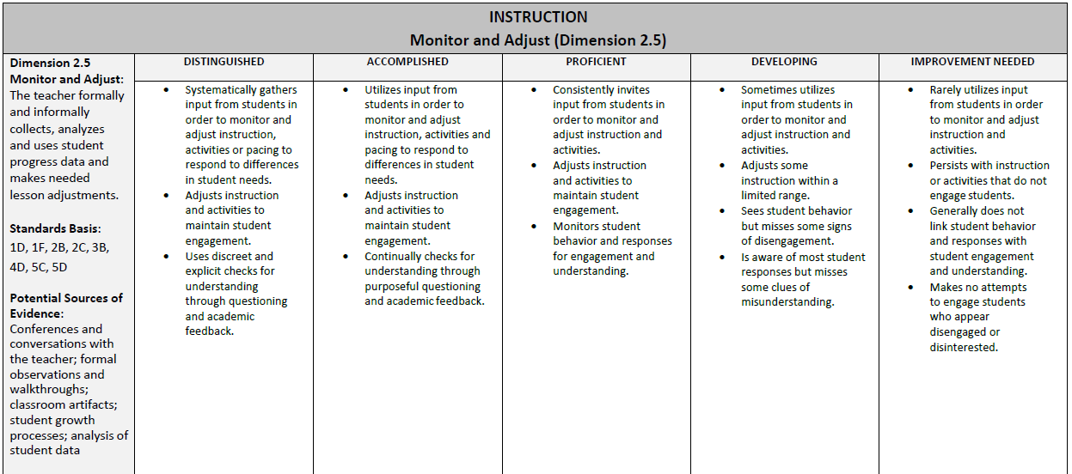
Evaluation Cycle – “POP” – 2
Teacher Outcomes:
To fully understand what teacher and student behaviors ‘look and sound like’ at the proficient, accomplished and distinguished levels as a means of developing highly-effective practices and performance levels over time.
Notes:
Emphasize that we want to move practices to the left over time, where student-centered instruction is the norm.
Read the following from the slide (click):
Teacher Outcomes:
To fully understand what teacher and student behaviors ‘look and sound like’ at the proficient, accomplished and distinguished levels as a means of developing highly-effective practices and performance levels over time.
It is imperative that appraisers and teachers have a clear and common understanding of what the descriptors (bullets) in each dimension ‘look and sound like’ and unpack or deconstruct each dimension over time to clarify practices. This also includes embedding district and campus initiatives, as applicable, to the descriptors, e.g., which specific technology are we expecting to see….what specific instructional strategies should teachers implement….?
“Let’s look closer at this outcome on the next slide.”

Slide 13
Given this….
Unpacking/Deconstructing the Rubric
6
Teacher Outcomes:
To fully understand what teacher and student behaviors ‘look and sound like’ at the proficient, accomplished and distinguished levels as a means of developing highly-effective practices and performance levels over time.
As a campus, what are the next steps to deepen our understanding of the rubric and its application, along with the connections to the Teacher Standards?
To what degree are we able to articulate what the behaviors look like when they are ‘student-centered’ in the accomplished and distinguished levels?
Notes:
Read through the slide and process the questions.
Have teachers respond to the questions on page 6.
(Two clicks are required on this slide.)
Debrief and tie to the deltas on slide 6/page 2.

Slide 14
Rubric Cross-Connections
Technology
Standards and Alignment
Activities
Communication
The descriptor topics in the rubric sometimes appear in more than one dimension. How does the meaning of the descriptor change across dimensions?
Notes:
Materials: Rubric (Standards and Alignment, Communication and Activities dimensions)
(click once only.)
“Some descriptor topics appear in multiple dimensions, e.g., technology, questioning, etc. This speaks to the holistic nature of the rubric. However, the context/lens for these topics changes based on the dimension which is being reviewed. Look through the dimensions in the rubric and find where technology is noted.”
Process this slide, having teachers discuss how technology appears in each of the identified dimensions and clarifying what the expectation is in one dimension as compared to the others. Debrief and possibly chart the differences.
(Click to reveal the connections across dimensions.)
Trainer notes/possible script:
Technology in Standards and Alignment – This is addressed as part of the planning domain; therefore, the initial filter is that technology is tied to planning. The descriptors in this dimension read, “Integration of technology, when applicable (proficient)…. Integration of technology to enhance mastery of goal(s) (accomplished/distinguished).” Given that this is the ‘Standards and Alignment’ dimension, the lens becomes ‘how the teacher designs clear, well-organized, sequential lessons that include technology, as applicable, to address the needs of students and meet the lesson outcomes.
Technology in Activities – This dimension is also part of the planning domain; therefore, the initial filter becomes how technology is used to plan activities that are engaging, flexible, and encourage higher-order thinking, persistence and achievement. The descriptors read: “Activities resources, technology and instructional materials that are all aligned to instructional purposes (proficient)… Activities, resources, technology and instructional materials that are all aligned to instructional purposes, are varied and appropriate to ability levels of students (accomplished)…. Activities, resources, technology and instructional materials that are all aligned to instructional purposes, are varied and appropriate to ability levels of students and actively engage in the ownership of their learning (distinguished). Technology in this context refers to how the teacher plans activities which are aligned to the learning outcomes and enhanced through the resources and technology in a way that supports the learning outcomes, rather than simply including technology as a random tool/resource. Technology is used to enhance the quality of the activities, including higher-order thinking, persistence and achievement.
Technology in Communication – This dimension is part of the instruction domain; therefore, the filter becomes how technology is used in the execution of the lesson to enhance teaching and learning. In this dimension, technology and visual tools are used to communicate with both the teacher and peers. The types of technology and how they are used should be clarified to create common understandings between appraisers and teachers.
Technology will also be embedded in other dimensions in more indirect ways, i.e., ‘classroom environment, routines and procedures’ as a means of assessing whether there are established routines and procedures when technology is being used, etc.

Slide 15
Rubric Cross-Connections – 2
Mastery of the Objective
Standards and Alignment
Activities
Achieving Expectations
Differentiation
Classroom Environment Routines and Procedures
Notes:
Process this slide the same as the previous slide. Teachers will look at how ‘mastery of the objective’ appears in each of the identified dimensions and the differences in how they are addressed. Remind them to use the dimension as initial discussion to clarifying the meaning.
(click once only.)
(After teachers have looked for the connections, click to show the dimensions.)
Debrief and possibly chart the differences.
The objective of this activity is for teachers to see how the practices are embedded and represented across dimensions in the descriptors of the rubric. The table discussion should be centered around how why the specific practice/behavior is represented in each of these specific dimensions.

Slide 16
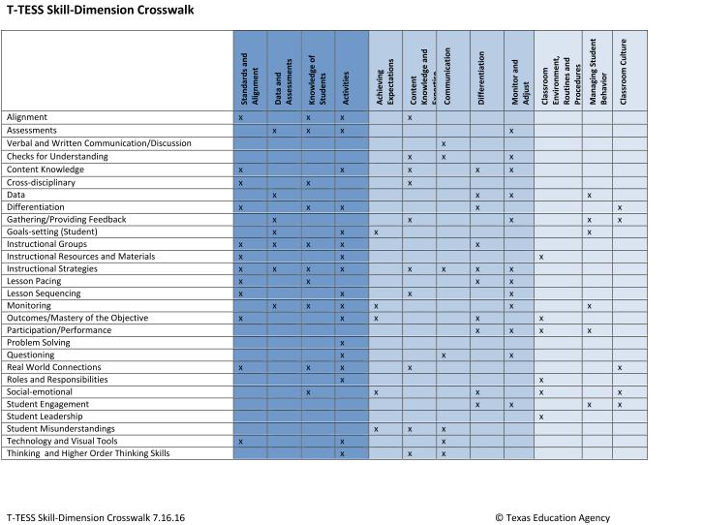
T-TESS Skill-Dimension Crosswalk
6
6
Notes:
Materials: Training Guide page 6.
Provide context for this handout by explaining to teachers that the practices/skills from the T-TESS rubric descriptors are noted on the left side, and the dimensions are reflected at the top. The “x” symbols indicate where the practices/skills are represented in the rubric. This crosswalk shows us an “at-a-glance” view of the rubric and communicates the holistic nature of the work. Skills are generally represented in the planning domain, instruction domain, and sometimes also in the learning environment domain.
As appraisers we collect evidence regarding the planning dimensions (pre-conferences, lesson plans, planning meetings, etc.) and identify where the evidence is best aligned. In some instances, the evidence may appear in more than one dimension as part of the rating process. Likewise, during the actual lesson, the appraiser is collecting evidence to show the relationship between the planning process and how the lesson is actually executed. Evidence during the lesson is collected and used to determine performance levels for domains 1,2, and 3, along with domain 4, as appropriate.
Ask, “What are the implications for this crosswalk?” “How does it help us?”
The emphasis for this slide is for teachers to see how the practices/skills are embedded throughout the rubric, rather than in isolation.
For appraisers, it’s important to look through this same lens to determine how areas of refinement might be selected to have the greatest impact, as well.

Slide 17
Talking Chips
Each person gets two chips.
When you want to respond, you must place one chip in the center of the table.
You can only speak if your chip is in the center.
When you have no chips you may only listen.
When everyone has used all their chips, take them back and start over until time is called.
Notes:
Materials: Talking Chips
Remind participants about the Talking Chips activity using this slide.

Slide 18
Post-Conferences
7
Introduction
Greeting
Review Conference Process
Reinforcement
Reinforcement Area (Dimension)
Self-Analysis and Follow-Up Questions
Ask a general impression question about the lesson.
Refinement
Refinement Area (Dimension)
Self-Analysis and Follow-Up Questions
Share Evidence for Reinforcement
Share Evidence for Refinement
Share Recommendations
Review Ratings
Share Evidence for Ratings
“Given your experiences last year, what are your recommendations for post-conferences?”
“How are you personally addressing your refinement areas?”
Notes:
Debrief this slide using the following two questions. Responses may be used to refine how post-conferences are conducted.
Teachers engage in table talk to respond to this first question using the talking chips. Debrief responses from the large group using the “rule of no repeat.”
“Given your experiences last year, what are your recommendations for post-conferences?”
Teachers respond to this second question individually first on page 7. Then table talk discussions are used for round two with the talking chips.
“How are you personally addressing your refinement areas?”

Slide 19
“True North”
True North refers to what we should do, not what we can do. It is a term used describe the ideal or state of perfection that your organization should be continually striving towards.
Opportunities for improvement never end, and it is only when we take the next step that we in fact see possible future steps.
True North works as a compass proving a guide to take an organization from the current condition to where they want to be. It is the persistent practice of daily improvement by all employees to advance to True North that makes organizations first class.
Notes:
Note: “True North” was coined and messaged by Toyota over 20 years ago.
Have the teachers stand and close their eyes. Tell them to follow the directions without opening their eyes.
Direct them to turn and face “north”.
Now have them open their eyes and see how the group is facing different directions.
While still standing, have them read the slide and debrief their reactions by asking, “What is this telling us and how does this impact our work with T-TESS?”

Slide 20
“True North” Implementation/Impact Needs Assessment
7
Teacher T-TESS Support
What processes should we implement to deepen our understanding with the rubric and correlating practices?
How are areas of reinforcement and refinement threaded with other aspects of the work and development?
How might team meeting agendas be more directly connected to the T-TESS rubric and process?
How should professional development be further linked to individual and collective areas of growth?
Notes:
Materials: Training Guide page 7, chart paper, markers.
Use this slide as a way to assess staff needs and determine next steps. Teachers write their responses on Training Guide page 7.
“In order to realize OUR “True North”…, turn to page 7 in your training guide and respond to the following questions.” (click)
Allow 4 minutes for teachers to respond, checking time for completion.
Debrief each question and chart responses as “action items” to consider.

Slide 21
“True North” Goal Setting and Professional Development
What recommendations do you have regarding refinement of the Goal Setting and Professional Development process?
What worked?
What needs work?
Notes:
Review the questions on the slide to emphasize continuous improvement as an ongoing process for the GSPD process.
Add to the “action items” chart when debriefing these questions.

Slide 22
“True North” Goal Setting and Professional Development – 2
7
Think about your goals which were established at the end-of-year conference.
In what ways will these goals enhance/hone your knowledge and skills this year?
How will the goals impact student achievement?
Are there any necessary revisions/changes?
How will you maximize professional development to further refine your practices?
Notes:
Materials: Training Guide page 7.
Have teachers think about the goals that were established at the end-of-year conference. (If teachers are new to T-TESS, have them think about possible areas by looking through the rubric, while returning teachers respond to these prompts.
Review the questions on the slide to emphasize continuous improvement as an ongoing process.

Slide 23
Building T-TESS Teacher Leaders
“Within every school there is a sleeping giant of teacher leadership, which can be a strong catalyst for making change.”
“Teacher leadership was defined as “the process by which teachers…influence their colleagues, principals, and other members of the school community to improve teaching and learning practices with the aim of increased student learning and achievement.”
“Research of high-performing schools indicates that those schools which develop cultures of collaboration and professional inquiry have success in improving student learning (Waters, Marzano & McNulty, 2008). Teachers possess capabilities and knowledge that are critically needed to strengthen school reform and improvement. In order to unleash these strengths, they need recognized responsibilities, authority, time to collaborate, and support from school administrators to assume leadership roles.”
Notes:
Review the quotes to emphasize the notion of building teacher leaders.
Ask, “What are you wondering or noticing, as you look at these quotes? How does this relate to T-TESS?”
Note: Domain 4 specifically addresses teacher leaders.

Slide 24
Quips and Quotes
“Though no one can go back and make a brand new start, any one can start from now and make a brand new ending.”
“The best part of teaching is that it matters.
The hardest part of teaching is that every moment matters, everyday.”
“If we are truly effective teachers, then we are creating autonomous, independent, and self-directed learners.”
Notes:
Have participants stand in groups of three or four teachers.
Show the first quote and have them react in their groups, using T-TESS and the basis for the conversation. Debrief two or three responses.
Now have one person from each group move to another group.
Show the second quote. Debrief two or three responses.
Have a new person from each group move to another group.
Show the third quote. Ask them to think about the notion of student-centered, student-led in the T-TESS rubric, and identify the connections with this quote to that expectation in classrooms.

Slide 25
Strong Circle
Using three words or less…,
tell us what you will each commit to do as we refine T-TESS implementation.
Notes:
This exercise is a relatively quick way to check in with a group at the beginning or end of a meeting/training and provides a sense of connectedness. It resembles the huddle in team sports and creates a feeling of solidarity and team effort.
“This refresher course has asked us to be reflective about our implementation, specifically areas of reinforcement (what’s working) and areas of refinement (growth) for us as a campus.”
“I’m going to ask you to generate a phrase. Using three words or less, tell us what you will each commit to do as we refine T-TESS implementation.” (Allow teachers time to think about a response before announcing the “Strong Circle.”)
A Strong Circle is announced (see script below). The group stands in a tight circle, shoulder to shoulder (perhaps with arms locked), --- everyone in the circle and no one outside the circle.
“When I say the words “Strong Circle”…, you will create a large circle by standing shoulder to shoulder. Ready? You’ve thought about your phrase? (Say “Strong Circle”)”
Now moving around the circle in a clockwise fashion, let’s hear your phrase. What do you commit to do to refine T-TESS implementation?”
Responses are shared clockwise around the circle.
The “trainer” may identify patterns that emerged after everyone has shared. Any appropriate closing comments are added.

Slide 26
Teach for Texas Portal
https://teachfortexas.org
Notes:
Remind teachers to visit the Teach for Texas portal as a means of identifying other resources and materials to deepen their own understanding of T-TESS and the process.
Appraisers should also continue to visit the portal as a means of building individual and collective capacity with T-TESS.

