Slide 1
Middle School Teacher Overview
Full Day
Notes:
Start time of 8:00 a.m.
Note: Trainer notes are included in this section and are also provided in the ‘Trainer Notes’ handout.
“Welcome….
The purpose for us meeting today is to collectively learn about the new Texas Teacher Evaluation and Support System…. also known as T-TESS. Our time together is intended to ensure that every one of you (teachers) has a clear understanding about the new system, the implications for teacher evaluations, and how it will support all of us in learning and growing as a school community, to ultimately impact our students’ performance.”

Slide 2
Objectives:
The teachers will:
become familiar with the T-TESS process;
begin to move from procedural to conceptual in understanding how the domains, dimensions, descriptors, and performance levels of the T-TESS rubric apply to their roles and responsibilities; and
understand that the T-TESS process is based on best practices and an ongoing system of feedback and support.
Notes:
Emphasize the fact that all teachers will be supported to gain a clear understanding of the rubric and how it applies to their roles and responsibilities with teaching and learning. The focus will be on collecting evidence before, during, and after the lesson and scoring the evidence based on the T-TESS rubric.
“The objectives for today are that each of you will….
Become familiar with the T-TESS process to continue improving professional practices as a school community of learners.
Move us from the procedural (step-by-step procedures) to conceptual (understanding T-TESS concepts and connecting and applying them in various situations) knowledge… including how the domains of the T-TESS rubric apply to teachers’ roles and responsibilities.
Recognize and collectively embrace the fact that T-TESS is a research-based process with a strong system of support intended to connect the appraisal system to training and professional development. “

Slide 3

Introductory Video
Notes:
Start time of 8:20 a.m.
”This video is an introduction to the T-TESS process and will provide some background and context for how the new system was developed and will be implemented. Several members of the steering committee who assisted with the development of the T-TESS process are in the video.”
Note: The length of the video is approximately 11 minutes.
Share the video.
Debrief:
Take 2 minutes at your table to discuss the following: “Based on what you saw and heard, what are you gathering about this system?”
Allow participants to share their thoughts, emphasizing that this process is about teacher and student growth and achievement.

Slide 4
It’s a Process, not an Event.
Overview and Introduction
Public Learners
T-TESS Experts
Notes:
Start time of 8:40 a.m.
Emphasize that just being exposed to the rubric is not sufficient.
“Today is about providing an overview and introduction. All administrators and teachers must go through in-depth practice and training to be fluent in all of its applications and uses.”
“We must embrace the fact that we will be public learners with this process. This means that we will spend additional time studying and applying the rubric in structured professional learning forums beyond today’s session to ensure that we understand it and are applying it as intended.”
“The campus goal is that we’re T-TESS experts and are using the tool to learn and grow as an organization… administrators, teachers, students and other stakeholders.”

Slide 5
Texas Teacher Standards
New!
149.1001 – Purpose: The standards identified in this section are performance standards to be used to inform the training, appraisal, and professional development of teachers.
Six (6) Standards
  Standard 1: Instructional Planning and Delivery
  Standard 2: Knowledge of Students and Student Learning
  Standard 3: Content Knowledge and Expertise
  Standard 4: Learning Environment
  Standard 5: Data-Driven Practice
  Standard 6: Professional Practices and Responsibilities
Texas Administrative Code, Chapter 149. – Effective June 8, 2014.
Notes:
“Effective June 8, 2014, Texas has new rules regarding Educator Standards. These new Texas Teacher Standards, along with research-based best practices provide the foundation for the T-TESS Rubric. Just like our TEKS for students, these standards define what teachers are supposed to know and be able to do.”
“Chapter 149.1001 clearly states that the purpose of these standards is to inform training, appraisal, and professional development for teachers. Training and professional development, or growth, are the impetus for the new evaluation system.
“This slide provides the categories for each of the standards. We will study these later; however, note the topics for each standard so that you can mentally connect them to the T-TESS Rubric.”

Slide 6
Requirements – Full Appraisal
Requirements
One observation
45 minute minimum (can be conducted in shorter increments based on context)
No requirements for announced versus unannounced
Post conference within 10 business days
Pre-conference is optional in year one, required year two and beyond
Goal-setting and professional development plan*
End-of-year conference as final collaborative meeting*
*Also required for teachers not undergoing full appraisal
Notes:
Note: Modify this slide to capture local decisions about number of observations, pre-conferences, etc..
“With the rollout of this new system comes new mind sets….we need to begin thinking about observations as a learning tool, rather than a ‘gotcha’ …We are learning organizations and should consistently model this as adult learners, as well.”

Slide 7
The Rubric
Created by a steering committee comprised of Texas Educators based on best practices, requirements with the new Texas Teacher Standards, and research…
Notes:
“The T-TESS Rubric was created by a steering committee comprised of Texas educators… and developed for Texas educators…to provide effective support, feedback and opportunities for professional growth.”

Slide 8
Elements of an Effective Lesson
Placemat Consensus
Consensus Elements
What are your favorite hobbies?
Notes:
Start time of 9:00 a.m.
Consensus Map: Need chart paper to complete these.
“We will be working together to create team Consensus Maps. We will need four teachers per chart. I’ll model the process before you complete your consensus map.”
(See next slide.)

Slide 9
Elements of an Effective Lesson
Placemat Consensus – 2
Person A: Basketball
Soccer
Gardening
Reading
Scrapbooking
Person B:
Gardening
Camping
Basketball
Soccer
Reading
Basketball
Gardening
Reading
Person D:
Woodworking
Basketball
Reading
Gardening
Collecting Cards
Person C:
Coin collecting
Interior Designing
Basketball
Gardening
Reading
What are your favorite hobbies?
Notes:
“You will be working in teams of four. Assume this team was asked to identify their favorite hobbies. Each person individually listed their hobbies in the space provided. --the consensus elements (Basketball, Gardening and Reading) are written in the middle, since everyone had these.”
We should have four teachers per chart (last team may have less if there are not enough teachers). Each person will take one section of the map to write your responses. Use a different color for each section. …Are we ready?”
See next slide. These consensus maps will be posted and referred to consistently throughout the training.

Slide 10
Placemat Consensus – 10 Minutes Total!
2 minutes to write individually
3 minutes to talk and reach consensus
Participant A
Participant B
Consensus Elements
5 minutes to debrief
Participant D
Participant
C
As you reflect upon a recent lesson you observed or delivered that was effective, what occurred during that lesson that led it to be effective?
Notes:
‘You will have 10 minutes total to complete the activity…. 2 minutes to write individually,… 3 minutes to talk and reach consensus…. And 5 minutes to debrief.”
“The prompt is as follows: (read the prompt from the slide)….”
Monitor and provide feedback.
Debrief:
“As I walked around the room, it was clear that there were many comments which were seen on multiple charts. Let’s debrief what is in each team’s consensus section…. “
Once each team has shared, follow with two questions for the teachers…
Why this question?: We want all participants to think about what they believe to be effective teaching….this should be the basis of their understanding of the rubric.
Why this way?: (Why did we process this way?) We want to show them that in order for there to be a shared understanding of what good teaching is, they all have to come to a consensus on what that would look like…the rubric will help to formalize this.

Slide 11

Effective Elements Summary
Rigorous and measureable goals aligned to state content standards
Student engagement and interaction
Alignment of activities and materials
throughout lesson
Student relevancy
Teacher displays content knowledge
Numerous checks for mastery
Teacher asks probing questions to
extend learning
Evidence of student mastery of the
objective
Differentiation
Notes:
Make connections to: “When a lesson is effective, we know it when we see it. But, when “it” is missing key elements, how do we communicate what is missing to someone else? How do we develop the missing skills in others? How do we measure “it”?
T-TESS provides us with what “it” is: what an effective lesson and effective teaching is, the process for building the skills in others, and the tools by which we measure it (T-TESS rubric and the correlating pieces).
There are many effective elements of a good lesson. The goal is creating instructional opportunities, or lessons, where the dimensions come together at higher performance levels.

Slide 12
T-TESS Rubric Overview -
Including Domain I or Alternate Domain I
Planning/
Lesson Internalization
Instruction
Learning Environment
Standards and Alignment
Data and Assessment
Knowledge of Students
Activities
Achieving Expectations
Content Knowledge and Expertise
Communication
Differentiation
Monitor and Adjust
Classroom Environment, Routines, and Procedures
Managing Student Behavior
Classroom Culture
Professional Practices and Responsibilities
Professional Demeanor and Ethics
Goal Setting
Professional Development
School Community Involvement
Notes:
“The T-TESS Rubric includes four broad categories, or Domains, and 16 Dimensions.”
Read each domain and the bulleted dimensions.
Please note that as of June 1, 2024 the Alternate Domain I Rubric, ”Lesson Internalization,” is available as an option for districts to use particularly when teachers are using HQIM/ OER materials. This is OPTIONAL and it is a district decision whether to use the original Domain I or the Alternate Domain I. For the remainder of this training, when referring to Domain 1, you will see it named “Planning/ LI.” LI refers to the Alternate Domain I Rubric - Lesson Internalization.
HQIM: High quality instructional materials
OER: Open education resource

Slide 13
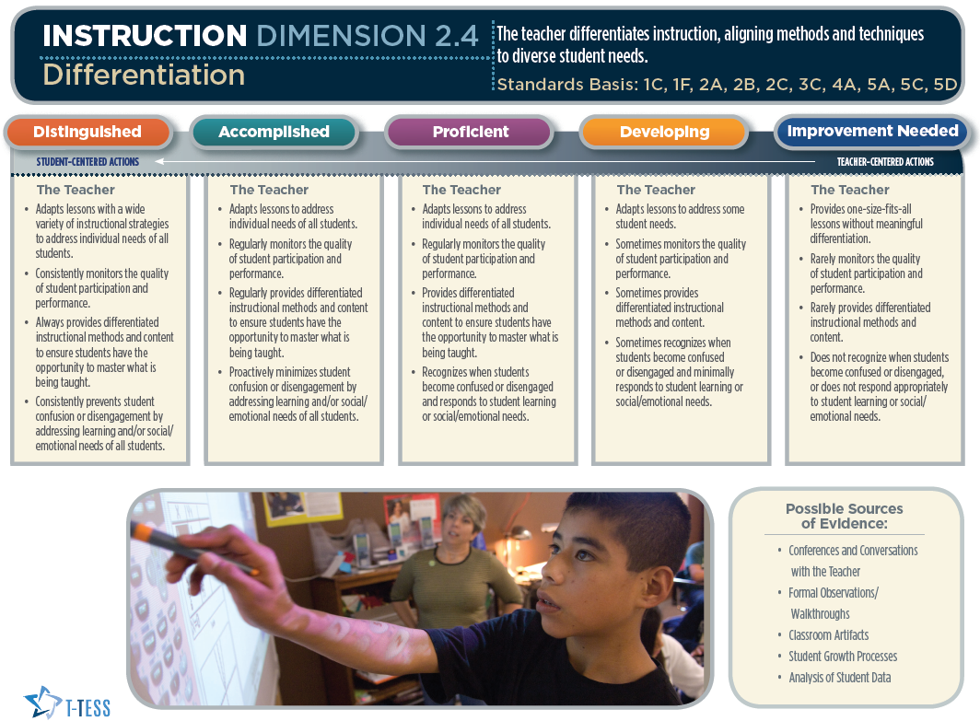
T-TESS Rubric
Handout
Notes:
Start time of 9:30 a.m.
Note: This slide provides an overview of the Rubric’s format.
Direct teachers to Teacher Handout #1, indicating that they will be seeing the “Working” version of the rubric which includes the same information as this stylized version.
“These next few slides will highlight each element of the rubric… the Domain, Dimension, Descriptors and Performance Levels.”

Slide 14
T-TESS Rubric – 2
Domain
Notes:
These slides will highlight each element of the rubric (Domain, Indicator, Descriptors and Performance Levels) in slide show mode.
“This section of the rubric is where we see the domain. In this case, it’s Instruction.”

Slide 15
T-TESS Rubric – 3
Notes:
These slides will highlight each element of the rubric (Domain, Indicator, Descriptors and Performance Levels) in slide show mode.

Slide 16
T-TESS Rubric – 4
Dimension
Notes:
“This section outlines the Dimensions…In this case it’s Differentiation.”

Slide 17
T-TESS Rubric – 5
Notes:
These slides will highlight each element of the rubric (Domain, Indicator, Descriptors and Performance Levels) in slide show mode.

Slide 18
T-TESS Rubric – 6
Descriptors
Descriptors
Notes:
These sections provide the descriptors for each performance level of the Differentiation dimension.

Slide 19
T-TESS Rubric – 7
Notes:
These slides will highlight each element of the rubric (Domain, Indicator, Descriptors and Performance Levels) in slide show mode.

Slide 20
T-TESS Rubric – 8
Performance Levels
Notes:
This slide shows the performance levels… Distinguished, Accomplished, Proficient, Developing and Improvement Needed.
Very Important...(Make sure teachers understand what is below.)
“When appraisers use the evidence to score a lesson, they will begin in the proficient column. This performance level – Proficient - signifies a ‘Rock Solid’ teacher. Let me say this again, Proficient is Rock Solid….
What does this mean? We will see a bell curve with T-TESS evaluations…. This is a culture shift in Texas. If teachers are Proficient and Rock Solid, then we will see a bell curve which indicates there are some that fall in the accomplished and distinguished levels and others that will be developing and improvement needed. This process is not about the person… it’s about how the lesson scores, using the evidence collected and the rubric descriptors for each dimension. What was ‘exceeds expectations’ in PDAS is now described in the ‘proficient’ level. Two additional performance levels, accomplished and distinguished, were added to allow for growth and aspiration.”

Slide 21
T-TESS Rubric Overview – 2
Planning/ LI
Instruction
Learning Environment
Standards and Alignment
Data and Assessment
Knowledge of Students
Activities
Achieving Expectations
Content Knowledge and Expertise
Communication
Differentiation
Monitor and Adjust
Classroom Environment, Routines, and Procedures
Managing Student Behavior
Classroom Culture
Professional Practices and Responsibilities
Professional Demeanor and Ethics
Goal Setting
Professional Development
School Community Involvement
Notes:
“As a reminder, this graphic shows us how the T-TESS Rubric includes four broad categories, or Domains, and 16 Dimensions.”
Emphasize that for today, they will spend time primarily on the Instruction and Learning Environment Domains.

Slide 22
Evaluation Focus
Learner Outcomes
Student Behaviors
Teacher Behaviors
B,M,E
cause and effect
Notes:
“Let’s talk briefly about the target for conducting T-TESS evaluations.”
Learner Outcomes: “When we talk about Learner Outcomes, we are referring to the TEKS or other standards (Pre-K Guidelines, ELPS, TA TEKS, etc.) As the appraiser in the classroom, I’m listening for the ‘Learner Outcomes’ or lesson objectives as the anchor for the appraisal. What are the outcomes? How are they communicated to students? What evidence is there to support that students understood the outcomes? These outcomes drive the entire evaluation.”
Teacher Behaviors: “Next, I’m collecting evidence regarding the teacher behaviors and how they are aligned to the learner outcomes. What is the teacher saying and doing that aligns with and supports the learning objectives? For example, how is the lesson structured and paced to facilitate student mastery towards the learner outcomes? How do questions, technology, etc., align with the learner outcomes?”
Student Behaviors: “I’m also collecting evidence regarding what they students say and do throughout the lesson using the learner outcomes as a filter for how students are ‘behaving’ and responding to instruction.”
There is a direct cause and effect relationship between what the teacher says and does and what the students say and do. Again, all linked to the learner outcomes.
Ultimately, I’m collecting evidence to support whether or not students are meeting the learner outcomes. As the appraiser, this means that I will need to know about other aspects of the lesson, including where the class is with the unit of study – just beginning the unit, middle of unit, end of unit, etc.”
B,M,E: All this evidence is captured at the beginning, middle and end of the lesson; thus observing the entire lesson is key.

Slide 23
What is the Process of Modeling Your
Thinking (Think-Aloud)
I
do
Think Aloud
We do
Scaffold & Cue
You do
Students Explain Thinking
Notes:
Start time of 9:45 a.m.
Let participants know that this will be the guiding structure for learning throughout the training and that we will be modeling good teaching and practice whenever possible. Point out that the gradual release of responsibility is widely recognized as an important part of effective teaching. You will be modeling effective teaching throughout the training.
Participants will notice that the trainer will be gradually releasing responsibility to them. So, each activity will begin with a model by the trainer, followed by a paired or group table activity and then to independence through the “you do” individual portion. The first step is the “I do”. You will model for them your thought process while highlighting one standard area on the rubric.

Slide 24
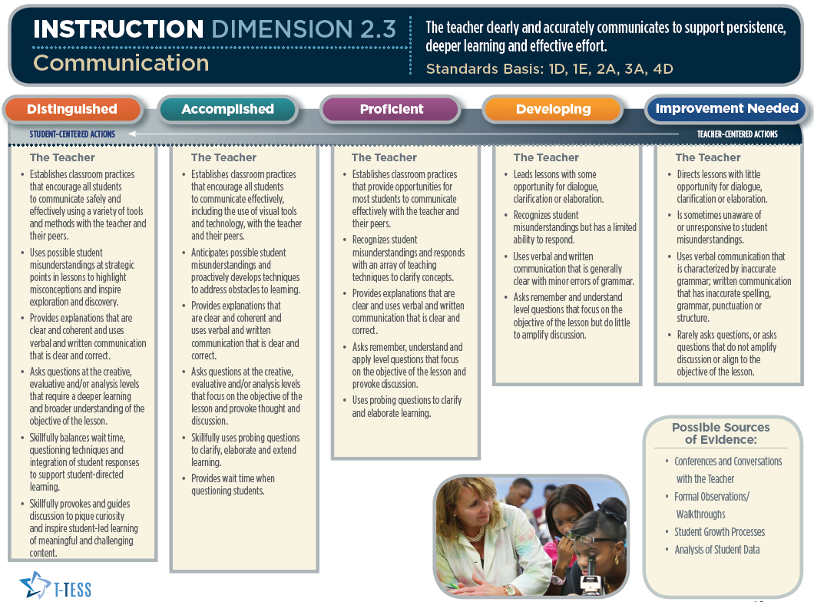
What is the Process of Modeling Your
Thinking (Think-Aloud) – 2
Handout
Notes:
Start time of 9:50 a.m.
Trainer will model how to highlight the Communication dimension and descriptors before participants highlight their rubrics. See Trainer Handout #1.
Start with the summary statement at the top of the rubric (The teacher clearly and accurately communicates to support persistence, deeper learning and effective effort.). Share which words you would highlight as key terms in the rubric.
Move to the ‘Rock Solid’ – Proficient Column – to highlight key words in the first descriptor, since this is where we begin scoring the lesson. Scan and compare the Accomplished and Distinguished descriptors to the left as you think out loud, followed by the Developing and Improvement Needed descriptors to the right, to show how the continuum changes across performance levels for the first descriptor.
Move to the Proficient level again with the second descriptor to highlight the key words and think out loud regarding what this descriptor looks like in practice. Review performance levels to the left and right, noting how they change.
Follow the same process with the remainder of the rubric, while teachers take notes on their rubric.
When finished, indicated that you just modeled the ‘I do’…. And will now move to the ‘We do’…

Slide 25
Rubric Activity
Handout
Directions:
Trainer just modeled metacognition for Communication.
Each group will use the same process to deconstruct the rubric for the following dimensions:
  Standards and Alignment (1.1)
  Content Knowledge and Expertise (2.2)
  Classroom Environment, Routines and Procedures (3.2)
You will have 5 minutes per dimension.
Notes:
Start time of 10:00 a.m.
Note: See below and in trainer manual. Set the timer in three, five-minute increments to pace the group with each dimension.
Teachers will read and highlight the dimension description on the left, move to the proficient column to read and highlight the first descriptor, make notes to define what this descriptor looks and sounds like in practice, then compare that descriptor across performance levels to determine how it changes. They will go back to the proficient column to look at the second descriptor and repeat the process for the entire dimension.
“We will now move to the ‘We do’… each table will be assigned three dimensions to highlight the key terms in the dimension (summary paragraph at the top) and the descriptors. Are there questions about the process at this point?”
To debrief the activity, remind the staff that it will be necessary to deconstruct the T-TESS rubric over time to ensure that everyone is interpreting and applying the rubric in the same manner.

Slide 26


10 minute Break
10:00
Notes:
Start time of 10:30 a.m.
In slide show mode, you will need to click on the inside of the circle and the timer will begin. The timer will begin filling in the beige part with blue once the timer begins.

Slide 27
Collective Evidence is Essential
Detailed Collection of Evidence:
  Unbiased notes of what occurs during a classroom lesson.
    Capture:
      what the teacher says
      what the teacher does
      what the students say
      what the students do
    Copy wording from visuals used during the lesson.
    Record time segments of lesson.
The collection of detailed evidence is ESSENTIAL for the observation process to be implemented accurately, fairly, and for the intended purpose of the process.
Notes:
Start time of 10:40 a.m.
“Collecting evidence is a critical part of the T-TESS process. Capturing what teachers say and do and what students say and do is essential to linking the evidence to the rubric descriptors and performance levels and accurately rate each dimension.”
“Evidence may be used for different aspects of the rubric which shows the connectivity and holistic nature of the model.”
“You will continue to hear us say,… and ‘Now let’s see how the lesson scored, based on the evidence and the rubric…!”

Slide 28
When Do You Collect Evidence
Prior to the Lesson
Being Observed
Prior to the Lesson
Being Observed
  Pre-conference
  Review of lesson and/or unit plans as applicable
During the
Lesson
  What the teacher says and does
  What the students say and do
After the
Lesson
After the
Lesson
  Communication between classroom observation and post-conference
Notes:
“There are three (3) different points during the evaluation process to collect evidence: Prior to the lesson, during the lesson, and after the lesson. While during the lesson is perhaps the MOST important time to collect evidence, it is not the only time. Before an announced observation there should be a pre-conference, and a review of materials, e.g., lesson plan, handouts, etc., and after all evaluations there should be a post-conference. The post-conference follows a very specific format.”
Review the slide points.

Slide 29
Evaluation Cycle
Observation
Post-Conference
Pre-Conference
Observation
Post-Conference
  Unannounced
  Announced
Notes:
Start time of 10:50 a.m.
“This slide shows us the key aspects of announced versus unannounced evaluations. Before an announced evaluation there should be a pre-conference, and a review of materials, and after all evaluations there should be a post-conference. Evidence is collected at all points.”

Slide 30

Stand up, hands up, pair up
Decide who will be partner A and who will be B.
Partner A responds to the prompt while partner B listens.
Partner A finishes, Partner B says, “What I heard you say was…”
Then Partner B responds to the prompt, while Partner A listens and then says…”What I heard you say was…”
Notes:
Trainer will follow directions on the slide for the stand up, hands up, pair up. One suggestion would be to use music when participants are selecting a partner in a musical chairs type fashion.

Slide 31

Stand up, hands up, pair up – 2
  What is your understanding of T-TESS at this point?
Notes:
Monitor as they talk. Have participants talk in pairs (per previous slide) and debrief a couple of key points.

Slide 32
When Do You Collect Evidence – 2
Prior to the Lesson
Being Observed
Prior to the Lesson
Being Observed
  Pre-conference
  Review of lesson and/or unit plans as applicable
During the
Lesson
  What the teacher says and does
  What the students say and do
After the
Lesson
After the
Lesson
  Communication between classroom observation and post-conference
Notes:
“There are three (3) different points during the evaluation process to collect evidence: Prior to the lesson, during the lesson, and after the lesson. While during the lesson is perhaps the MOST important time to collect evidence, it is not the only time. Before an announced observation there should be a pre-conference, and a review of materials, e.g., lesson plan, handouts, etc., and after all evaluations there should be a post-conference. The post-conference follows a very specific format.”
Review the slide points.

Slide 33
T-TESS: Evidence-Based Process
What do you view as the purpose for a pre-conference?
3:00
What are the benefits for you, the teacher?
Notes:
Start time of 11:05 a.m.
“Let’s think about the purpose of the pre-conference. At your table, you will have three minutes to discuss these two questions:
What do you view as the purpose for a pre-conference? … and… What are the benefits for you, the teacher?”
Be prepared to share your responses.”
The purpose of the pre-conference may include responses such as:
to clarify the lesson from both perspectives (administrator and teacher)
to provide the teacher time to share his/her planning and lesson design process
to provide the administrator an opportunity to clarify what he/she might see/hear during the observation
to help the teacher think through the lesson
- etc.
Highlight the benefits that support the purpose and intent for T-TESS which include teacher and student growth and success.

Slide 34
Purpose of the Pre-Conference
To provide the teacher with an opportunity to share his/her thought process in developing the lesson/plan and provide additional details about the upcoming observation.
To clarify expectations for teacher and student performance.
To provide the appraiser with information about the lesson observation and criteria that may not be directly observable.
Notes:
Start time of 11:30 a.m.
“Let’s think about the purpose of the pre-conference. At your table, you will have three minutes to discuss these two questions:
What do you view as the purpose for a pre-conference? … and… What are the benefits for you, the teacher?”
Be prepared to share your responses.”
The purpose of the pre-conference may include responses such as:
to clarify the lesson from both perspectives (administrator and teacher)
to provide the teacher time to share his/her planning and lesson design process
to provide the administrator an opportunity to clarify what he/she might see/hear during the observation
to help the teacher think through the lesson
- etc.
Highlight the benefits that support the purpose and intent for T-TESS which include teacher and student growth and success.

Slide 35

View a Lesson
We will now watch a lesson.
Assume you are the appraiser.
What is your task as an appraiser during the lesson?
Notes:
Start time of 12:30 p.m.
The teachers will view a lesson and script. Remind them that they will need the evidence to score the lesson; therefore, their task is to script. See next slide for teacher guidance on what to script.

Slide 36
Scripting the Lesson Reminders
What does the teacher say?
What does the teacher do?
What do the students say?
What do the students do?
    - Copy wording from visuals used during the lesson.
    - Record time segments of lesson.
Notes:
Start time of 12:35 p.m.
Share this slide as a reminder. Let them know that there is no right or wrong way to script. They are to capture as much as possible of the key points in the lesson that will provide evidence for the descriptors.

Slide 37
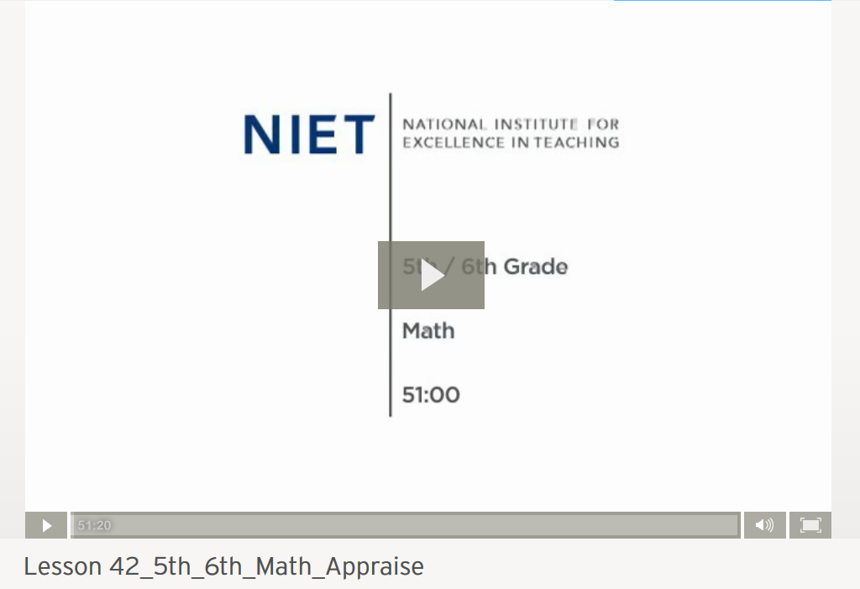
View Math ELA Lesson Video
Notes:
Start time of 1:25 p.m.
Teachers view the lesson and script…

Slide 38
Observation of Classroom Instruction
Reflect on the lesson you just viewed and the evidence you collected.
Based on the evidence, do you view this teacher’s instruction ‘Proficient’, ‘Above proficient’, or ‘Below proficient’ ?
A thumbs up is above proficient, a thumbs down is below proficient, and in the middle is proficient.
Notes:
Have teachers provide a holistic rating for the lesson (with their eyes closed) using a thumbs up, down, or in the middle signal as noted in the third bullet.

Slide 39
Categorizing Evidence (We do)
Using the template provided, we will categorize evidence for:
    Achieving Expectations (2.1)
    Content Knowledge and Expertise (2.2)
    Differentiation (2.4)
    Monitor and Adjust (2.5)
    Classroom Environment, Routines and Procedures (3.2)
First, categorize your evidence as a table group.
Then, based on the evidence and the rubric, assign ratings to the dimension.
You will have 10 minutes to complete the activity.
Notes:
Start time of 1:30 p.m.
Materials: Teachers’ scripted notes, rubric dimensions, Teacher Handout #2.
Teachers will now use their scripted notes (evidence) and categorize this evidence according to the rubric. See Teacher Handout #2.
Assign one dimension per table, repeating, as necessary, based on the number of tables. Each table group will only be assigned one dimension. Ideally there are two tables per dimension to compare and calibrate ratings.
Remind teachers that they are looking at their specific dimension in the rubric, and beginning at the Proficient level to collect and document their evidence. Their evidence should be specific and clearly connected to the descriptors.

Slide 40

Whole Group Debrief
We will debrief
the evidence as a whole group.
Notes:
Start time of 2:25 p.m.
Trainers should make sure they are familiar with the evidence and ratings and should be prepared to defend the evidence/ratings. Trainers should refer to the national raters as the T-TESS raters.
“We will debrief one dimension at a time. Each table group will share one or two strong pieces of evidence and the rating assigned, based on the evidence and the rubric. As you hear the evidence from other dimensions, take notes on your handout (Teacher Handout #2).”
After debriefing each dimension, share the T-TESS rater scores with the group. (Trainer Handout #2 - Lesson Evidence and Ratings sheet.)

Slide 41
Four Key Elements of the
Instruction Post-Conference
Introduction
Greeting
Review Conference Process
Reinforcement
Reinforcement Area (Dimension)
Self-Analysis and Follow-Up Questions
Ask a general impression question about the lesson.
Refinement
Refinement Area (Dimension)
Self-Analysis and Follow-Up Questions
Share Evidence for Reinforcement
Share Evidence for Refinement
Share Recommendations
Review Ratings
Share Evidence for Ratings
Notes:
Start time of 2:45 p.m.
Introduce participants to the post-conference format.
“This slide provides the Four Key Elements to the Instructional Post-Conference, which follows the lesson. (Review the chart.)”
While watching the post-conference participants will fill in the areas of the post-conference that they observe, i.e. the general impression question, what the reinforcement area was, what the evidence was, etc.. Ask participants why we would wait until the end of the post-conference to share ratings and evidence. The responses from the participants to this question should be about how they want to encourage reflection; sharing ratings at the beginning of the conference will distract from the purpose of professional growth and reflection on the lesson observation.

Slide 42

Post-Conference Round Table
As a classroom teacher, what do you want from a post-conference?
Using your talking chips/clips, each participant will share two things a classroom teacher should want from a post conference
Notes:
(Use chips or paper clips for this activity.)
Possible answers:
- To provide verbal feedback to the observed teacher based on evidence from the lesson
- Create an opportunity to coach the teacher in an area of reinforcement (strength) and area of refinement (need)

Slide 43
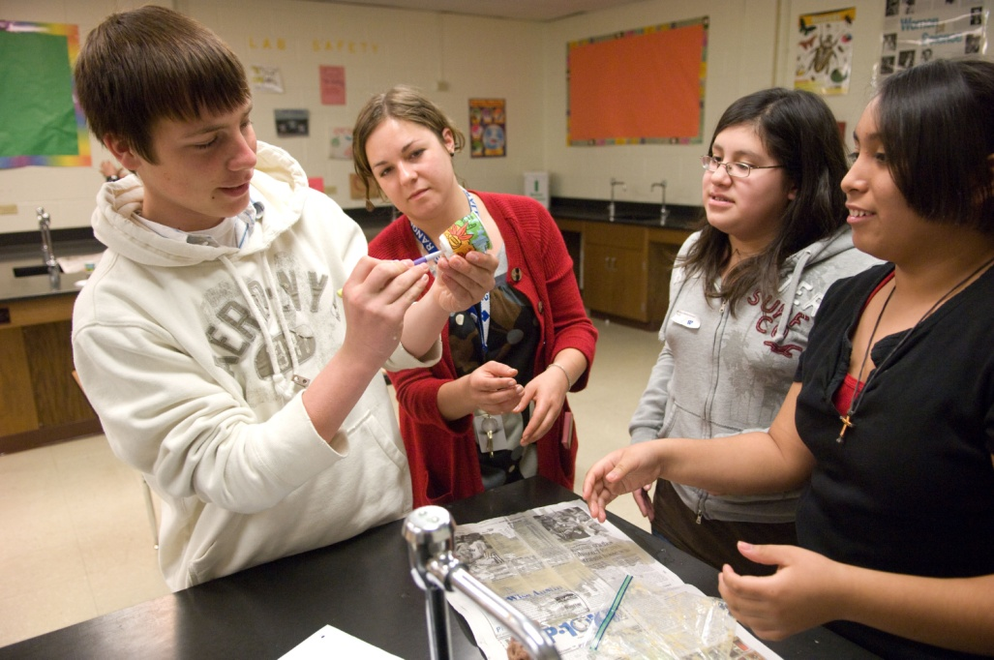
Post-Conference Round Table – 2
As a classroom teacher, what do you NOT want from a
post-conference?
Using your talking chips/clips, each participant will share two things a classroom teacher should not want from a post conference.
Notes:
Create a poster with two columns: Want and Don’t Want.
Debrief by asking participants to share their ‘wants’ and ‘don’t want’ responses without repeating what has been shared.

Slide 44
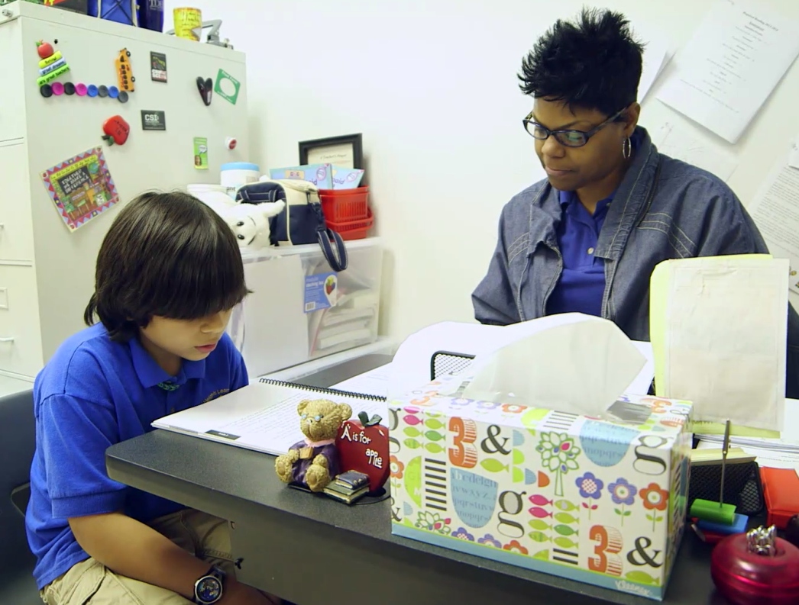
Before We Watch the Post-Conference
Please write 3-5 questions you would ask the teacher from the video.
Turn to a shoulder partner and compare the questions.
Notes:
Start time of 3:00 p.m.

Slide 45

As We Watch the Post-Conference
Please write all questions that the conference leader/appraiser asks.
Note how the questions facilitate teacher reflection.

Slide 46
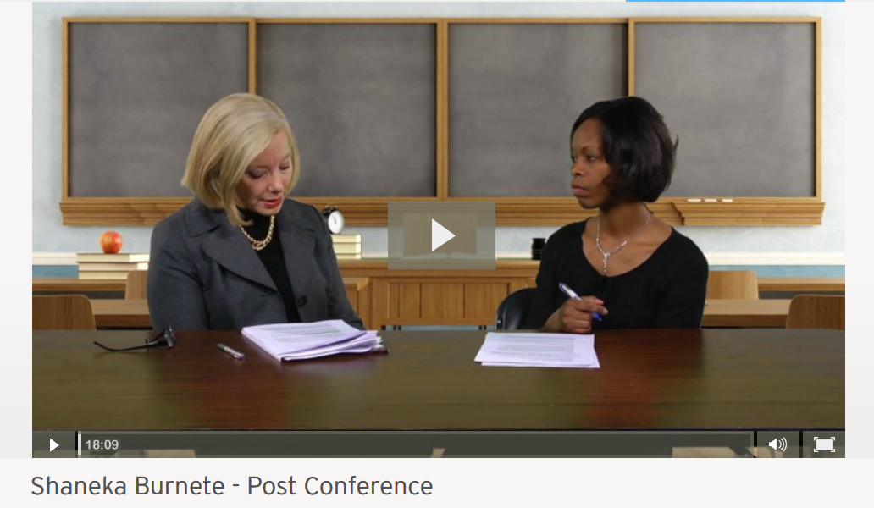
4th Grade Math Lesson Post-Conference Video
4th Grade Math Lesson Post-Conference Video
Notes:
View the post-conference.

Slide 47
What did you observe during the post-conference video?
What questions did the post-conference appraiser ask?
How did the questions facilitate teacher reflection?
What did you observe during the post-conference that was on your chart earlier for what you Want/Don’t Want from a Post-Conference?
Notes:
(Review the slide and allow a 5 minute table talk.)
Debrief: “What behaviors did you notice during this post-conference?”
Compare to the Want/Don’t Want chart….
“ At this point, we have had an opportunity to analyze the rubrics and understand the components of the observation cycle: pre-conference, observation and post-conference.”

Slide 48
Objectives: - 2
The teachers will:
become familiar with the T-TESS process;
begin to move from procedural to conceptual in understanding how the domains, dimensions, descriptors, and performance levels of the T-TESS rubric apply to their roles and responsibilities; and
understand that the T-TESS process is based on best practices and an ongoing system of feedback and support.
Notes:
Review objectives with the participants.
“Let’s review our objectives to make sure we are on target.”

Slide 49
T-TESS Thoughts…
"Great teaching is at the core of every quality education system.“
"Research shows that there is no greater in-school factor than having an outstanding educator in the classroom.“
T-TESS was developed by educators for educators.
T-TESS is aligned to research-based, best practices for teaching and learning.
The T-TESS Rubric aligns directly with the new Texas Teacher Standards.
The T-TESS process provides for actionable, timely feedback, allowing teachers to set goals and identify professional development that will lead to refinement in knowledge and skills.
Notes:
Start time of 3:50 p.m.
(Review the slide to pull key points together.)
Remind participants of the expectations and that we are still moving along the continuum of procedural to conceptual. The next slide will give them a chance to debrief the learning so far.

Slide 50
T-TESS Thoughts… - 2
T-TESS Thoughts…
The 'Proficient' performance level is representative of a 'Rock Solid' teacher.
There will be some necessary culture shifts to establish a new mind set for the relationship with appraisals and supporting teachers.
Everyone in the school community is a public learner.
The ultimate outcome is improved student achievement.
Notes:
(Review the slide to pull key points together.)

Slide 51
Here’s What…So What…Now What…
Here’s What…
(T-TESS
Key
Points)
So What…
(So, what are your “take-away” points?)
Now What…
(Now, what do you need?)
Notes:
Start time of 4:00 p.m.
Remind participants of the expectations and that we are still moving along the continuum of procedural to conceptual knowledge. This slide will give them a chance to debrief their learnings and professional needs thus far.
Have them complete Teacher Handout #3 and leave their copies for next steps and follow-up.

Slide 52
Thanks for Your Participation!
For more resources please visit our website:
TeachforTexas.org
Notes:
“Thank you…”
Connect to your district/school goals and outcomes for student achievement…

