Slide 1
Goal Setting and
Professional Development Plan
Teacher Overview
Notes:
Note: The bold text in the notes section is the suggested script for this presentation which is provided to teachers. Administrators/appraisers are encouraged to enhance the slides to reflect the expectations and needs of the district/campus.
Several slides have animation transitions; therefore, the notes include (click) to signal the trainer.
Use this slide to set the stage for the overview.
Goal-Setting and Professional Development (GSPD) Plan talking points to use throughout the training are:
GSPD is an ongoing, recursive process where teachers:
Reflect on current professional practices,
Identify professional growth goals,
Establish professional development plan to attain those goals,
Track progress towards goals over the course of the year, and
Reflect on goal attainment, including how the goals and professional development actually refined practices in a way that had enduring impact on the performance of their students.
GSPD is intended to foster authentic practices where teachers continuously self-reflect, set goals, and engage in high-yield professional development strategies that consistently build awareness of their strengths and limitations to hone and refine their craft over time.
Goals should be specific to each individual teacher and connected to refining their own practices, rather than campus-wide goals that are expected for all staff.
Teachers engage in goal setting, followed by ongoing, relevant and targeted professional learning opportunities that align with their professional growth goals to strengthen instructional effectiveness with the overall purpose of addressing students’ needs and improving performance – teacher and student.
The initial goal-setting conference with the appraiser and teacher is critical to the T-TESS support system, as it ensures that both the teacher and appraiser are clear about the goals and subsequent actions to reach the desired outcomes. It is also an opportunity for the teacher to outline the support systems needed to achieve the goals.
As a result of the self-reflection and goal setting processes, teachers implement changes in practice. Evidence is collected to support how professional practices are enhanced as a result of this continuous improvement cycle and the impact those changes are having on student performance.
Effective teachers understand the importance of using self-reflection and ongoing self-assessment to enhance teaching effectiveness, and identify and use appropriate resources and support systems inside and outside the school to address professional development needs for themselves and others.
Establishing systems where administrators and other colleagues use coaching to assist teachers in planning and reflecting on changes in practice is a proven method of supporting other professionals and a part of the GSPD process.
How does the GSPD process unfold throughout the year?
Teachers will participate in the T-TESS orientation at the beginning of the year. During this time, or through a separate meeting with teachers, appraisers will explain the GSPD process and expectation for teachers to self-assess, generate goals, and identify the professional development needed to meet those goals.
Teachers will individually (or collaboratively with their team) use student data to assess student needs and data related to their own performance/practices to determine their (teacher) needs, as initial self-assessment.
Teachers will draft their goal(s).
Districts will decide locally where to capture this information, although Texas has a GSPD template that may be used or modified, according to local expectations. (This is the template we share beginning on page 42 of the Training Guide.)
Within six weeks from the day of the completion of the T-TESS orientation, goals are submitted to the appraiser for review and approval.
A GSPD Conference is required for a teacher in the first year of appraisal under T-TESS or for teachers who are new to the district (even if they were participating in T-TESS in their previous district.) Necessary supports should be discussed and clarified.
The appraiser must approve the goals.
The GSPD plan should be maintained and tracked by the teacher to reflect progress towards the attainment of the goals, participation in professional development, and the impact of those goals on both teacher and student performance. Note: The appraiser will also be collecting evidence throughout the year for the dimensions in Domain IV.
Ideally, school administrators/appraisers provide structured opportunities for teachers to review their goals throughout the year, e.g., during pre-conferences, staff meetings, team meetings, etc., as a means of modeling the expectation for teachers to use these goals to drive practices.
If during the year, the appraiser(s) note that there are specific patterns with performance/practices, appraisers should use the GSPD process to generate a new goal and professional development to refocus the teacher on this new “need.”
The GSPD plan (and ideally evidence) should be shared with the appraiser prior to the end-of-year conference. Note: Part II of the GSPD template provides reflective questions for teachers to process their goals prior to the end-of-year conference.
The GSPD plan is used during the conference to reflect on how goals were met, the professional development impact on the goals/practices, how goals will be extended, next steps, etc.
At the end of the year, goals are drafted during the end-of-year conference for the following school year. (Note: They are revised, as needed, during the beginning of the next school year and submitted to the appraiser within the first six weeks of instruction.)
The GSPD plan is used after the end-of year conference to determine ratings for the Goal-Setting (4.2) and Professional Development (4.3) dimensions.

Slide 2
What is the purpose of the Goal-Setting and Professional Development Plan process?
GSPD is an ongoing, recursive process through which teachers authentically engage in reflection about current professional practices, identify individualized professional growth goals, establish and implement a professional development plan to attain those goals, and track progress toward the goals over the course of the year.
Notes:
Let’s begin by thinking about this question:
What is the purpose of the Goal-Setting and Professional Development Plan process?
Texas Administrative Code, Chapter 149.1001 related to the Texas Teacher Standards states that (click):
GSPD is an ongoing, recursive process through which teachers authentically engage in reflection about current professional practices, identify individualized professional growth goals, establish and implement a professional development plan to attain those goals, and track progress toward the goals over the course of the year.
Ask the teachers: What key words do you hear/see embedded in this expectation? (Listen for responses.)
As professionals in the field where learning is our focus (education), it is apparent that we should consistently be thinking about how we are learning and growing to stay current and identifying ways to ensure that we are always performing at our best in order to have the greatest impact with students.

Slide 3
T-TESS System Overview
Development
Support
Growth
Collaboration
T-TESS
Notes:
The T-TESS system (click) as a whole focuses on continuous professional growth where all teachers consistently hold themselves to high standards for professional development to improve their instructional effectiveness, knowledge and skills. The emphasis is on creating and maintaining a high-performing campus where a strong school culture of continuous improvement with
(click) growth,
(click) development,
(click) support and
(click) collaboration are the norm.
Think for a second about the actions associated with these terms and how those apply to you individually and us, collectively.
Ongoing feedback and collaborative support for learning are embraced by all staff, and this learning has a positive impact on teacher quality and student achievement.
Regardless of how long we have been in the profession, we continuously seek ways to learn, grow, and challenge ourselves. We are a community of learners.

Slide 4
Why?
Commitment to Developing Effective Instructional Practices
Notes:
Taking this a step further…..
Why do we engage in goal setting and establish a professional development plan?
When the goals are on target and the plan is executed with “heart”,…we see teachers authentically reflective about their practices and how those practices impact student learning. They value and embrace learning and growing, ….always seeking ways to strengthen their expertise.
(Click) --- There is a commitment to developing effective instructional practices …. Teachers know where they need to grow and with a strong plan and support systems, they make this happen.

Slide 5
Texas Administrative Code, Chapter 149.1001
Texas Administrative Code,
Chapter 149.1001
Standard 6 - Professional Practices and Responsibilities
Teacher self-reflection of strengths and professional learning needs,
Establishing personal goals to strengthen their instructional effectiveness and better meet students’ needs, and
Engagement in relevant, targeted professional learning opportunities aligned to their goals.
Notes:
(click) The expectation for goal setting is directly tied to Texas Administrative Code, Chapter 149.1001 of the Texas Teacher Standards.
Standard 6 for Professional Practices and Responsibilities addresses the expectation for:
(click) Teacher self-reflection of strengths and professional learning needs…..
(click) Establishing personal goals to strengthen their instructional effectiveness and better meet students’ needs….
(click) And engagement in relevant, targeted professional learning opportunities aligned to their goals.
When these things happen consistently over time, we will see practices and performance shifting, as well.

Slide 6
Focus Questions
How do we, as a community of learners, establish a culture where goal-setting and ongoing learning are valued and embraced in our school community?
How is the Goal-Setting and Professional Development Plan used as the central tool to systematically focus teachers on continuous, self-directed improvement of practices?
Notes:
Let’s look… at two focus questions (click) to help set the foundation for the goal setting and professional development process.
(click) Knowing that the culture of an organization dictates both values and behaviors, the first question is - How do we, as a community of learners, establish a culture where goal-setting and ongoing learning are valued and embraced in our school community?
Also, because we’re looking at a systems approach to implementation, the second question then becomes - How is the Goal Setting and Professional Development Plan used as the central tool to systematically focus teachers on continuous, self-directed improvement of practices?
A rooted culture and a systematic approach create the foundation for this process to thrive.

Slide 7
Linking this together…
Goal Setting
Self-Assessment
Professional Practices & Student Performance
Professional Development Plan
The teacher self-assessment, goal setting and professional development processes are all interwoven and applied throughout the year to positively impact each teacher’s professional practices and ultimately increase student performance.
Notes:
As we link the T-TESS process together, this graphic shows us that the teacher self-assessment, goal setting and professional development processes are all interwoven and applied throughout the year to positively impact each teacher’s professional practices and ultimately increase student performance.
We will see how these come together initially and throughout the year.

Slide 8
What actually happens…?
Goal-Setting and Establishing a Professional Development Plan
Preliminary Goal-Setting and Planning for Following Year
Professional Development Plan Implementation
Formative Reviews
Prepare for End-0f-Year Conference
End-of-Year Conference
Teacher Self-Assessment
Notes:
Review the slide to explain the big picture GSPD process.

Slide 9
What actually happens…? - 2
Beginning of Year
Throughout the Year
End of Year
Notes:
There are specific actions which occur at the beginning of the year, throughout the year, and at the end of the school year to create the cycle for growth and development over time from one year to the next.

Slide 10
What actually happens…? - 3
Teacher “Orientation” of the Process
Self-Assessment: Data and Rubric Review to Determine Need
Formulate Goal(s) to Address the Need
Develop a Goal-Setting and Professional Development Plan
Track Goal Progress and Results Throughout the Year
Prepare for End-of-Year Conference to Discuss Goal Progress/Attainment
Establish Preliminary Goals for the Following Year
Formatively Review Goals and Professional Development Plan
Following Year
Continuous Improvement
Formalize
Notes:
The annual goal setting cycle begins with ….
Step 1: An Orientation– When initially implementing the T-TESS model, an orientation process is provided for teachers, to include an orientation, and an overview of the Goal Setting and Professional Development process. (Must be completed no later than the final day of the first three weeks of school and at least two weeks before the first observation.)
Step 2: Self-Assessment– For this self-assessment,…teachers will independently and/or with their team review both student and teacher data, including the connections to the T-TESS Rubric domains, dimensions, and descriptors to determine the “need.” A driving question is “How do these needs translate to a goal that will have an impact on both teacher and student performance?” (Occurs following the orientation.)
Step 3: Formulate Goal(s) (Within six weeks of the orientation) – Goals are formulated based on the data and identified needs in Step 2. The SMART goal process is recommended to ensure that the goal is specific, measurable, attainable, rigorous/realistic, and timely. The teacher also identifies specific types of professional development, including job-embedded options, along with other types of support necessary to accomplish the goal.
Step 4: Develop a Goal-Setting and Professional Development Plan – (Within six weeks of the orientation) – It is required that a Goal Setting Conference with the appraiser is conducted to review the goal(s) [if the teacher is new to T-TESS or the district], determine if any adjustments to the goal are necessary, identify the types of support needed from the appraiser, outline milestones that will help the teacher know that the goals are on track, and determine the specific types of evidence that will be collected to demonstrate progress/mastery towards the goal(s). The appraiser is required to approve the goals.
These initial steps are completed in Part I of the Goal Setting and Professional Development template.
Throughout the Year
Step 5: Formative Reviews (Ongoing) – Teachers regularly monitor their goal progress and how the professional development supports the goal(s). Goals may be modified in conjunction with the appraiser, when necessary, based on new data and needs. Formative reviews may occur in varied platforms,… for example…, one-on-one conferences such as pre- and post-conferences, staff meetings, department meetings, or other structures that lend themselves to this type of review. The objective is for teachers to continuously stay focused on how they are making progress towards attaining the goal(s). Appraisers are also collecting evidence to support dimensions 4.2 (Goal Setting) and 4.3 (Professional Development) throughout the year, including the impact on dimensions in Domains 1, 2 and 3.
End-of Year
Step 6: Prepare for End-of-Year Conferences (Several weeks before the end of the school year) – End-of-Year Conferences are scheduled. Both teachers and appraisers gather evidence collected throughout the year in preparation for the end-of-year conference discussions. Teachers must share the data/evidence with the appraiser prior to the end-of-year conference.
Step 7: End-of-Year Conferences are conducted at least 15 days prior to the last day of school. There are several key components to End-of Year Conferences. First, discuss are held regarding the final scores for Domains 1, 2 and 3. Second, teachers and appraisers also share the evidence/data that was collected all year for Domain 4, with an emphasis on Goal Setting and Professional Development. The conversations are focused on how the goal(s) were met and specific professional development and growth that occurred to meet those goals. If goal(s) were not met, the appraiser uses coaching to help the teacher analyze why the goal(s) were not met, what might have happened differently, the effect of not meeting the goal(s), and next steps. Also, teachers generate draft goals and professional development activities for the following year.
Step 8: Establish Preliminary Goal(s) for the Following Year – As just discussed, during this End-of-Year Conference, new goal(s) are formulated for the following year, along with preliminary discussions about potential professional development to meet the goal(s). Data that was collected all year, including area(s) of refinement, are also used to generate these tentative goals.
Following Year
Because this is a cycle of continuous improvement, teachers who were already involved in the T-TESS process generated preliminary goal(s) for this next school year. Teachers should revisit the goals at the beginning of the year to determine if the goal(s) are still appropriate and make adjustments with appraiser input, as necessary, based on current data and the new group of students.
For new teachers, the cycle begins with the orientation, then moves to the GSPD process.

Slide 11
The Following Year…
Beginning of Year
Throughout the Year
End-of Year Conference
DRAFT GOALS
Following Year…
Notes:
When the new year approaches it’s important to communicate how the prior year’s learning and draft goals are transitioned to the new school year to show that ongoing, continuous improvement is the new norm. The goals may need to be modified at the beginning of the new school year based on new teaching assignments, new data, etc., prior to being reviewed and approved by the appraiser.

Slide 12
The Following Year… - 2
Professional growth goals drive changes in practices… which results in increased student performance.
Notes:
Review the slide to emphasize how the goals should drive changes in practices and impact student performance. The research consistently shows that there is a direct correlation between teacher performance and student performance.

Slide 13
“How do I begin the Goal-Setting and Professional Development process?”
Review the campus/district vision, mission, and goals, as a basis for aligned decisions to begin thinking about your goals.
Conduct a self-assessment to determine:
Student Needs
Review data related to my students’ academic and developmental needs
Teacher Needs
Review data and the T-TESS Rubric related to my current and past performance
Notes:
Review the talking points on this slide.
Note: Teachers independently, and perhaps collectively with their team, review data and reflect on their professional practices, including reviewing the domains, dimensions, and descriptors of the T-TESS rubric. As a result of this self-assessment, the teachers formulate targeted goals to discuss with the appraiser during the Goal Setting Conference. The initial goal-setting conference with the appraiser and teacher is critical to the T-TESS support system, as it ensures that both the teacher and appraiser are clear about the goals and subsequent actions to reach the desired outcomes. It is also an opportunity for the teacher to outline the support systems needed to achieve the goals.

Slide 14
Think About It…
What do I want to change about my practice that will effectively impact student learning?
How can I develop a plan of action to address my professional learning?
How will I know if I accomplished my objective?
Notes:
Review the talking points on this slide. These key questions drive how goals are generated.
Provide teachers with time to reflect on these questions prior to beginning the goal-setting process. Ask teachers to share what they want to change in their own practice with an elbow partner, their team, or other small group.

Slide 15
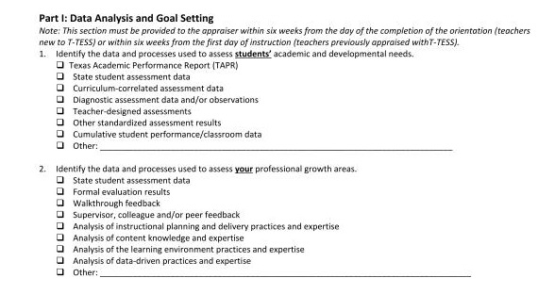
Think About It… - 2
Notes:
Note: If the district has developed a separate template, replace the GSPD template photo on this slide and the following slide with the local option.
Review Part I of the GSPD template.
You may want to share all or some of the following information to help teachers understand how to generate their goal(s).
There are many options for reviewing a teacher’s own data and student-level sources. The state has provided a sampling of options for data collection within the TTESS Goal-Setting template. However, explain that teachers do not have to use all of these sources, and there may be others that are more relevant to their teaching assignment.
Ultimately, teachers want to collect enough data to clearly formulate a need and help generate targeted goals that will shift their practices and impact student performance.
The data collection process is ongoing.
The goal-setting process is a dynamic process and may need to be revised throughout the year. A question to consider in revising the goals mid-year is whether the goal is still accurate or whether it needs to be revised based on changes in teacher/student need(s). Appraisers should probe further to determine why the goal needs to be revised.
New teachers with limited data may consider conducting their self-assessment based on performance in their university programs, student teaching, or other educational endeavors and continuously revisit the goals to determine if data during the year warrants changes in the goal(s).
If teachers have little or no student data, they may analyze current data sources, and establish processes for collecting additional data to gauge whether the goals are having the intended impact on student performance throughout the year.

Slide 16
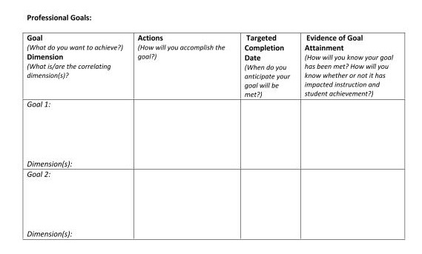
Think About It… - 3
Notes:
Review the template as a means to guide the development of the goals and professional development plan. Note that the professional development is captured in the “Actions” column.
The “Evidence of Goal Attainment” column is critical to ensuring that both the appraiser and teacher are clear about the types of evidence that will support how goals are met over time.
Throughout the year, teachers formatively review their goals and professional development plan to determine how goals are being met. Ideally, this includes reflective conferences with administrators, peers, or other professional colleagues. As result of the self-reflection and goal setting processes, teachers implement changes in practice. Evidence is collected to support how professional practices are enhanced as a result of this continuous improvement cycle and the impact those changes are having on student performance. Establishing systems where administrators and other colleagues use coaching to assist teachers in planning and reflecting on changes in practice is a proven method of supporting other professionals and a part of goal-setting.

Slide 17
SMART Criteria
Specific | What do you want to accomplish? Who, What, Where, When, Which, Why
Measurable | How will you demonstrate and evaluate the extent to which the goal has been met?
Ambitious/ Attainable/ Actionable/ | How can you set or stretch challenging goals within your own ability to achieve the desired outcome? What is the action-oriented verb?
Relevant | How does the goal tie into your key responsibilities? How is it aligned to your objective? Is it aligned to best practices and research and/or district/campus/team priorities?
Time-Bound | Does it have a clear end or target date with intermittent benchmarks to guide your goal to a successful and timely completion? Deadlines, Dates, Frequency, Etc.
Notes:
Emphasize that SMART criteria are used to develop the goals.
Note: Teachers should ensure that the goal(s) are specific to their own practices, rather than written solely about student performance. Campus-wide goals are part of the campus improvement plan, rather than the individual teacher’s GSPD plan.
Depending on district expectations, SMART criteria may be embedded within the language of the goal itself or within the teacher’s Professional Development Plan.

Slide 18
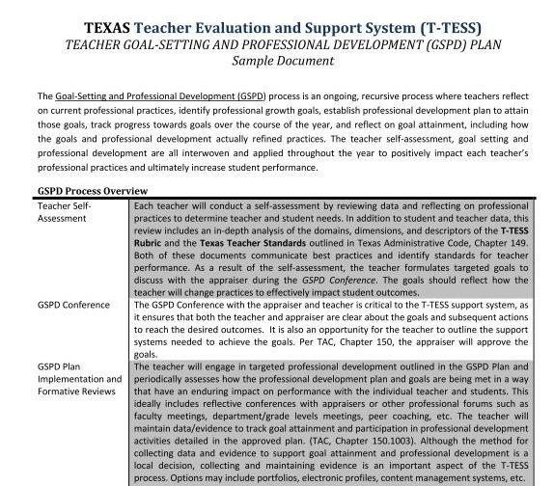
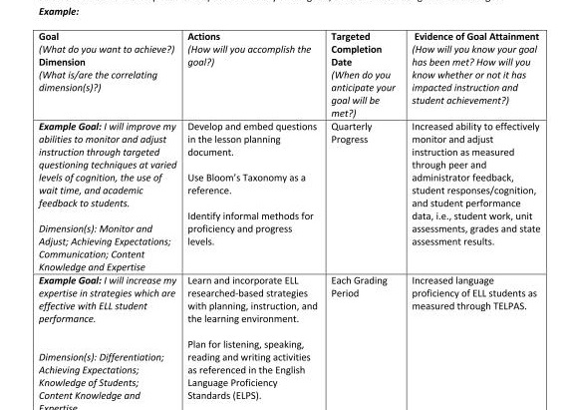
Sample Goal Review
Notes:
See the supplemental GSPD Plan Sample document.

Slide 19
Texas Administrative Code, Chapter 150.
The GSPD Plan shall be:
Submitted to the teacher’s appraiser within the first six weeks from the day of completion of the T-TESS orientation for teachers new to T-TESS or the district.
Drafted at the end-of-year conference and submitted to the teacher’s appraiser within the first six weeks of instruction for teachers who were previously appraised with T-TESS.
Approved by the appraiser.
Maintained throughout the course of the school year by the teacher to track progress and attainment of goals and participation in professional development activities detailed in the approved plan.
Notes:
Review the talking points on the slide.
Consider discussing the last bullet regarding how teachers are expected to maintain their documentation or have them brainstorm options.

Slide 20
Texas Administrative Code, Chapter 150. - 2
The GSPD Plan shall be:
Shared with the appraiser prior to the end-of-year conference.
Used after the end-of-year conference in the determination of ratings for the goal setting and professional development dimensions of the T-TESS Rubric.
A GSPD Conference is required for all teachers in the first year of appraisal under T-TESS and for teachers who are new to the district.
Notes:
Review the talking points on the slide.

Slide 21
GSPD as a Connected Process
T-TESS Rubric
Teacher Data
Student Data
Texas Teacher Standards
GSPD Plan
Other
Notes:
Discuss the connections between each of these and how they work together to inform practices.

Slide 22

Goal Setting and Professional Development Plan
Establish a positive correlation between the quality of teaching and learning,
Target instructional decisions based upon student data,
Create a mechanism for teacher refinement of practices, and
Increase effectiveness of instruction via the teacher’s continuous professional growth.
Why?
Notes:
Note: Display this slide to see the various transitions.
T-TESS fosters professional growth by encouraging teachers to set high standards for their professional development to improve their instructional effectiveness, knowledge and skills.
Goal setting is intended to…
Establish a positive correlation between the quality of teaching and learning,
Target instructional decisions based upon student data,
Create a mechanism for teacher refinement of practices, and
Increase effectiveness of instruction via the teacher’s continuous professional growth.
(click)
Why do we do this?
(click)
Imagine the potential when every teacher in every school is focused on reflective practice, seeking feedback, and committed to ongoing development of knowledge and skills. It’s about performing at our very best to impact every student, every day, as they prepare to walk the stage - college and career ready.

